Slide 1
Secure Data hiding in images using steganography
Secure The Data To Prevent Hackers
Presented By:
Student Name : Mohit Kala
College Name & Department : Graphic Era University, Dehradun, Uttarakhand (Computer Science and Engineering)

Slide 2
OUTLINE
Problem Statement
Technology used
Wow factor
End users
Result
Conclusion
Git-hub Link
Future scope

Slide 3
Problem Statement
Secure communication is crucial in today’s digital world.
Traditional methods of data transmission are prone to interception.
Steganography can hide data in images, but often lacks strong security.
This project aims to enhance security by incorporating encryption and decryption in image-based steganography.

Slide 4
Technology used
Python: The primary programming language used for implementing the encryption, decryption, and steganography processes.
OpenCV: A computer vision library used to manipulate and process images for hiding and extracting data.
File Handling: Used to read and write data to/from image files, ensuring proper storage and retrieval of hidden information.
IDE: VS Code (Visual Studio Code) was used for coding, debugging, and running the project.

Slide 5
Wow factors
Password-Based Authentication: The project incorporates a password-based authentication system for both encryption and decryption, ensuring that only authorized users can access or hide data within the image.
Simple Yet Effective: Despite its simplicity, the project effectively combines both encryption and steganography, providing a layered approach to securing data. It hides data in images while ensuring the data is encrypted for added protection.
Dual Security Mechanism: By using both password protection and image-based steganography, the project offers a higher level of security compared to standard steganographic techniques, making it harder for unauthorized parties to both detect and decode the hidden data.
Practical Application: This method of secure data hiding can be used in real-world scenarios, such as confidential communication or watermarking sensitive information, demonstrating its practical value in protecting data.

Slide 6
End users
Individuals: Those who need to securely share sensitive data, such as personal documents or passwords, without the risk of interception.
Businesses: Companies that require secure communication methods for confidential information, such as legal documents, financial reports, or internal communications.
Government Agencies: Entities dealing with classified or sensitive data that need to ensure privacy and prevent unauthorized access or leaks.
Researchers & Developers: Those in the field of cybersecurity or data privacy who want to explore steganography and encryption methods to enhance security in digital communications.

Slide 7
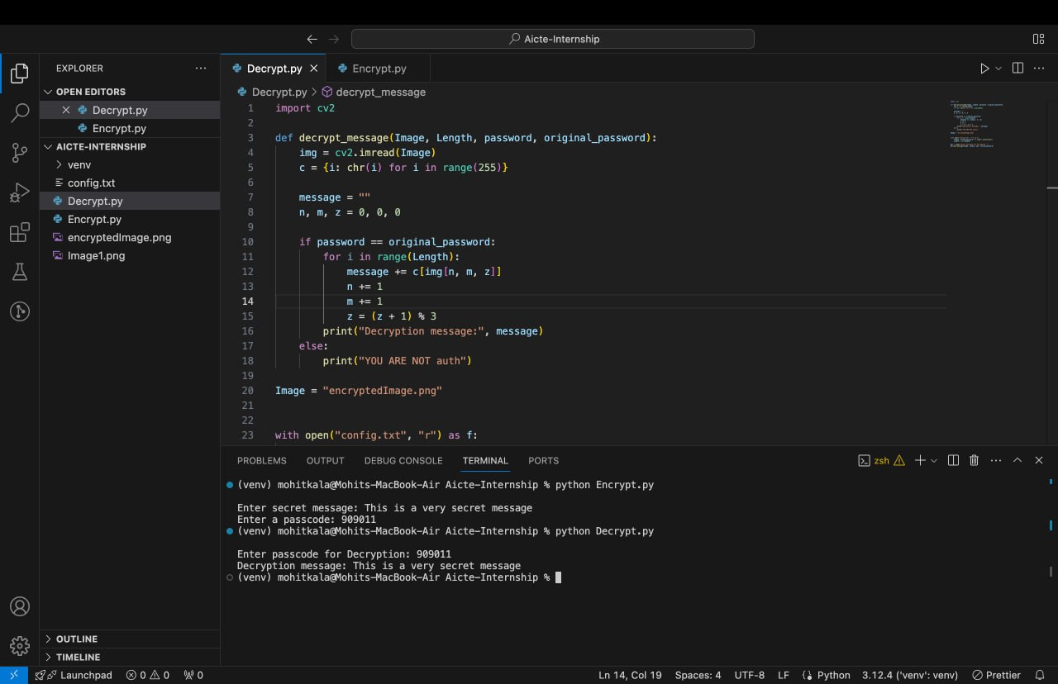
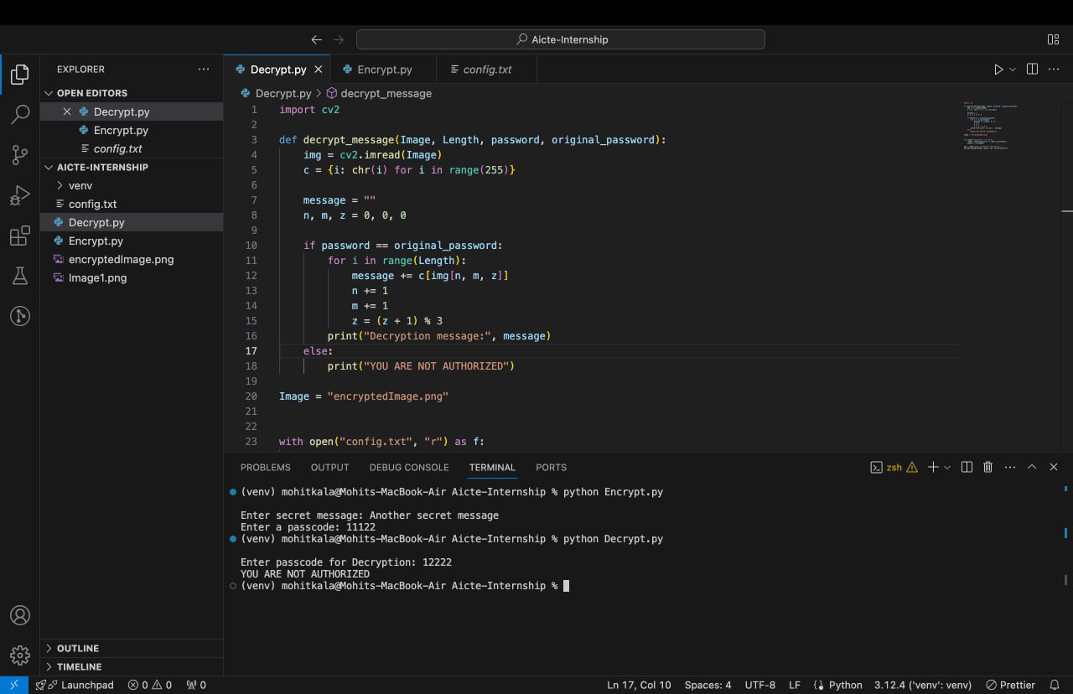
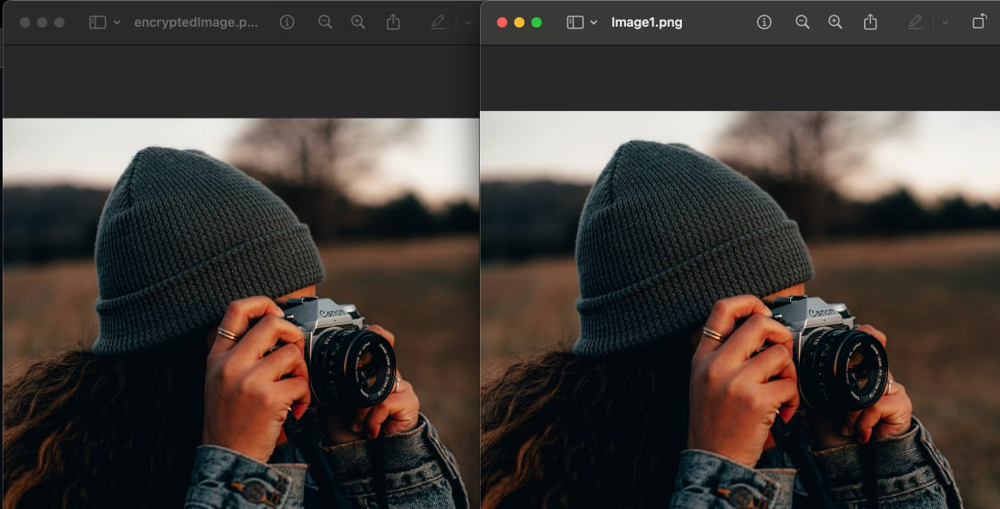
Results

Slide 8
Conclusion
This project successfully demonstrates a simple yet effective method of secure data hiding using steganography combined with encryption and password authentication. By using Python, OpenCV, and file handling techniques, it ensures that sensitive data can be securely embedded within images, making it virtually undetectable. The password protection adds an additional layer of security, ensuring that only authorized users can access the hidden data. This approach offers a practical solution for secure communication, making it useful for individuals, businesses, and organizations that require privacy and data protection.

Slide 9
GitHub Link
https://github.com/Evan-Balck/Aicte-internship

Slide 10
Future scope
Advanced Encryption Algorithms: Future improvements could include implementing more advanced encryption techniques (e.g., AES or RSA) to further enhance data security beyond basic password protection.
Detection and Prevention of Steganalysis: Developing methods to make steganography more robust against detection tools (steganalysis) would improve its security, making it harder for attackers to detect hidden data.
Real-Time Encryption and Decryption: Future versions could allow real-time embedding and extraction of data in video files or live streaming content, offering dynamic security for multimedia data.
User-Friendly Interface: A graphical user interface (GUI) could be developed for non-technical users, making it easier to encrypt, decrypt, and manage hidden data within images

Slide 11
THANK YOU

